Slide 1
Cornerstone City Church Peninsula Plus Community Hoo Are Ya
9th February 2025

Slide 2


Slide 3
Thanksgiving
CCLI Song # 7199589
Nick Herbert | Taku Mudere | Zo Chilengwe
© Capitol CMG Genesis; Safe and Sound Music; Remaining portion is unaffiliated
For use solely with the SongSelect® Terms of Use. All rights reserved. www.ccli.com
CCLI Licence No. 33265

Slide 4
1/8
Enter in (Enter in)
His courts with praise (His courts with praise)
For He is greatly (He is greatly)
To be praised (To be praised)

Slide 5
2/8
What shall we do
We shall lift up a shout
What shall we do
We shall praise Him
What shall we do
For our God made a way
We'll give Him our thanksgiving

Slide 6
3/8
Magnify (Magnify)
His Holy Name (His Holy Name)
For He is greatly (For He is greatly)
To be praised (To be praised)

Slide 7
4/8
What shall we do
We shall lift up a shout
What shall we do
We shall praise Him
What shall we do
For our God made a way
We'll give Him our thanksgiving

Slide 8
5/8
Even if the rocks cry out
We're gonna drown them out
With a louder shout of praise
Even when the battles roar
We're gonna praise You Lord
'Cause You are always worthy

Slide 9
6/8
You are worthy
Worthy of honour and praise
You are worthy
We'll sing it again and again

Slide 10
7/8
What shall we do
We shall lift up a shout
What shall we do
We shall praise Him
What shall we do
For our God made a way
We'll give Him our thanksgiving

Slide 11
8/8
We'll give Him our thanksgiving
We'll give Him our thanksgiving

Slide 12
Glorious Day
CCLI Song # 7081388
Jason Ingram | Jonathan Smith | Kristian Stanfill | Sean Curran
© 2017 KPS 1.0 (Admin. by Capitol CMG Publishing)
sixsteps Music (Admin. by Capitol CMG Publishing)
sixsteps Songs (Admin. by Capitol CMG Publishing)
Sounds Of Jericho (Admin. by Capitol CMG Publishing)
Worship Together Music (Admin. by Capitol CMG Publishing)
worshiptogether.com songs (Admin. by Capitol CMG Publishing)
Fellow Ships Music (Admin. by Essential Music Publishing LLC)
Hickory Bill Doc (Admin. by Essential Music Publishing LLC)
So Essential Tunes (Admin. by Essential Music Publishing LLC)
For use solely with the SongSelect® Terms of Use. All rights reserved. www.ccli.com
CCLI Licence No. 33265

Slide 13
1/6
I was buried beneath my shame
Who could carry that kind of weight
It was my tomb 'til I met You

Slide 14
2/6
I was breathing but not alive
All my failures I tried to hide
It was my tomb 'til I met You

Slide 15
3/6
('Cause when) You called my name (and)
I ran out of that grave
Out of the darkness into Your glorious day
You called my name (and) I ran out of that grave
Out of the darkness into Your glorious day

Slide 16
4/6
Now Your mercy has saved my soul
Now Your freedom is all that I know
The old made new Jesus when I met You

Slide 17
5/6
I needed rescue my sin was heavy
But chains break at the weight of Your glory
I needed shelter I was an orphan
Now You call me a citizen of Heaven
When I was broken You were my healing
Now Your love is the air that I'm breathing
I have a future my eyes are open

Slide 18
6/6
('Cause when) You called my name (and)
I ran out of that grave
Out of the darkness into Your glorious day
You called my name (and)
I ran out of that grave
Out of the darkness into Your glorious day

Slide 20
Firm Foundation (He Won't)
CCLI Song # 7188203
Austin Davis | Chandler Moore | Cody Carnes
© 2021 For Humans Publishing (Admin by Essential Music Publishing)
Maverick City Publishing (Admin by Essential Music Publishing)
Capitol CMG Paragon (Admin. by Capitol CMG Publishing)
TBCO Publishing (Admin. by Capitol CMG Publishing)
Writer's Roof Publishing (Admin. by Capitol CMG Publishing)
A.L.K.D. Music (Admin. by Watershed Music Group (Admin. by Capitol CMG Publishing))
For use solely with the SongSelect® Terms of Use. All rights reserved. www.ccli.com
CCLI Licence No. 33265

Slide 21
1/7
Christ is my firm foundation
The rock on which I stand
When everything around me is shaken
I've never been more glad
That I put my faith in Jesus
'Cause He's never let me down
He's faithful through generations
So why would He fail now

Slide 22
2/7
He won’t
He won't

Slide 23
3/7
I've still got joy in chaos
I've got peace that makes no sense
So I won't be going under
I'm not held by my own strength
'Cause I've built my life on Jesus
He's never let me down
He's faithful in every season
So why would He fail now

Slide 24
4/7
He won’t He won't
He won't fail
He won't fail

Slide 25
5/7
Rain came and wind blew
My house was built on You
I'm safe with You
I'm going to make it through

Slide 26
6/7
I'm going to make it through
‘Cause I’m standing strong on You
I’m going to make it through
‘Cause my house is built on You

Slide 27
7/7
Christ is my firm foundation
The rock on which I stand
When everything around me is shaken
I've never been more glad
That I put my faith in Jesus
'Cause He's never let me down
He's faithful through generations
So why would He fail now

Slide 29
Build My Life
CCLI Song # 7070345
Brett Younker | Karl Martin | Kirby Kaple | Matt Redman | Pat Barrett
© 2016 Capitol CMG Genesis (Admin. by Capitol CMG Publishing)
Housefires Sounds (Admin. by Capitol CMG Publishing)
sixsteps Music (Admin. by Capitol CMG Publishing)
Vamos Publishing (Admin. by Capitol CMG Publishing)
worshiptogether.com songs (Admin. by Capitol CMG Publishing)
Said And Done Music (Admin. by Integrity Music Ltd)
Thankyou Music (Admin. by Integrity Music Ltd)
Martin, Karl Andrew (Admin. by Sentric Music)
Bethel Music Publishing (Admin. by Song Solutions)
Kaple Music (Admin. by Song Solutions)
For use solely with the SongSelect® Terms of Use. All rights reserved. www.ccli.com
CCLI Licence No. 33265

Slide 30
1/4
Worthy of ev'ry song we could ever sing
Worthy of all the praise we could ever bring
Worthy of ev'ry breath we could ever breathe
We live for You

Slide 31
2/4
Jesus the name above ev'ry other name
Jesus the only one who could ever save
Worthy of ev'ry breath we could ever breathe
We live for You
We live for You

Slide 32
3/4
Holy there is no one like You
There is none beside You
Open up my eyes in wonder and show me who You are
And fill me with Your heart
And lead me in Your love to those around me

Slide 33
4/4
I will build my life upon Your love
It is a firm foundation
I will put my trust in You alone
And I will not be shaken

Slide 34


Slide 35
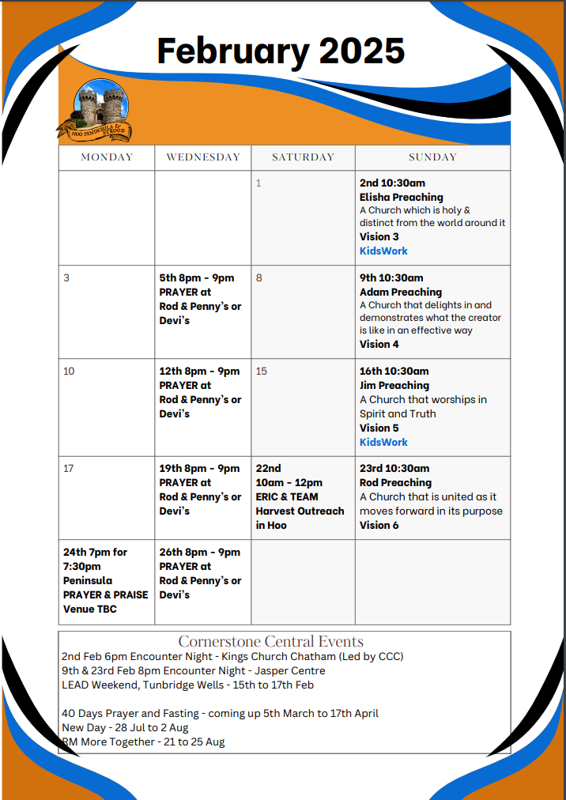

Slide 36

Grow Group 1
Grow Group 1 Name: On YOUR MARK!

Slide 37
Leaders
Leaderss
Phil & Kim
Maria (Mia) Warren
Matthew Harrison
Richard & Elisha Acheampong
Phil & Kim
Maria (Mia) Warren
Matthew Harrison
Richard & Elisa Acheampong

Slide 38
Q1 into Q2 Meeting Dates
Q1 into Q2 Meeting Dates
Month | Date / Day | Host
January | Saturday 11th | Maria
 | Wednesday 22nd | Maria
February | Saturday 8th | Venue Needed
 | Wednesday 19th | Phil & Kim
March | Saturday 8th | Richard & Elisha
 | Wednesday 19th | Venue Needed
April | Saturday 12th | Matt
 | Wednesday 30th | Venue Needed

Slide 39

Storm Walker
Storm Walker
Symbolising, trust in Jesus Christ through life's storms.
Mark 4:35-41

Slide 40


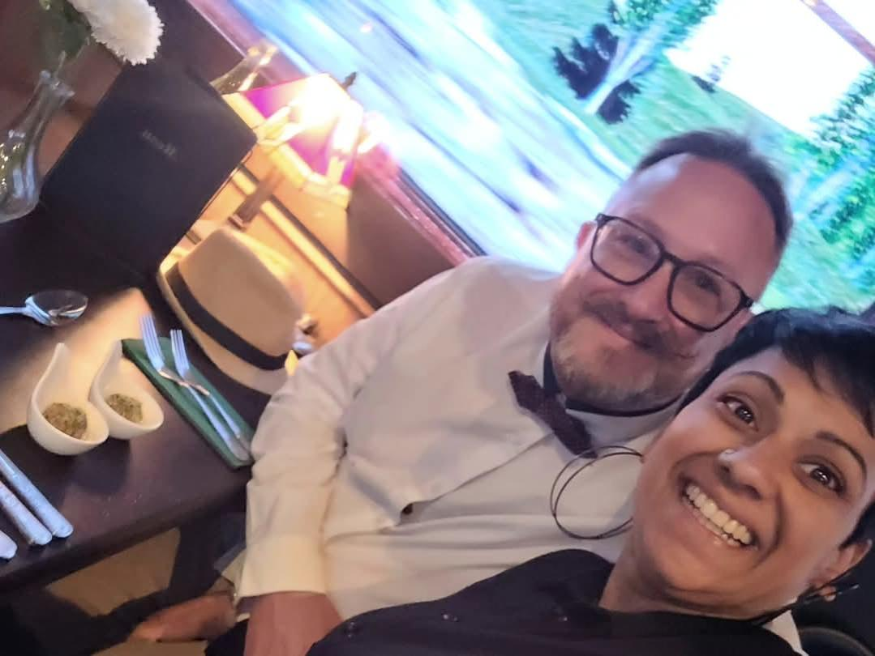
Group Leaders
Micheal and Mwamba
Wilfred and Parveen
Hannah

Slide 41
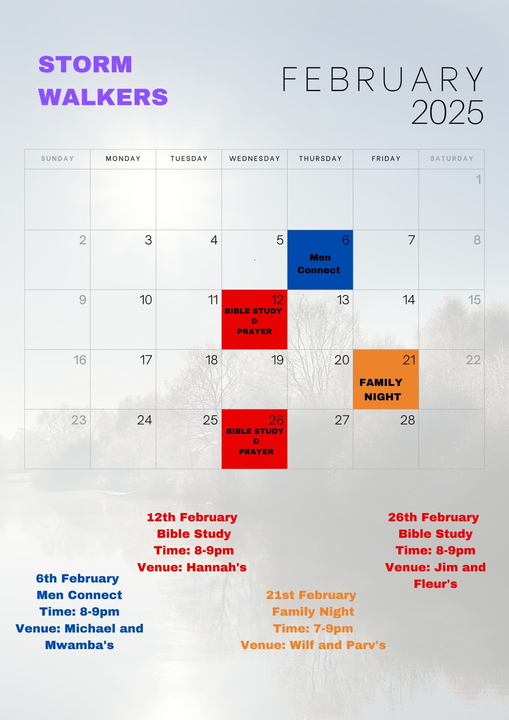

Slide 42
The Bereavement Journey
The Bereavement Journey is for anyone who has been bereaved at any time and in any way Starts Monday 3rd March
7 Sessions ending at Easter
Daytime group 10.30am to 12.30pm Jasper Centre
They may look to run another one in the evening later in the year
Please note that (as the video highlights) this is for anyone that has lost someone in their life
who would benefit and value time to reflect and work through their grief and loss.
It doesn’t have to be very recently. Angela and Lena

Slide 43
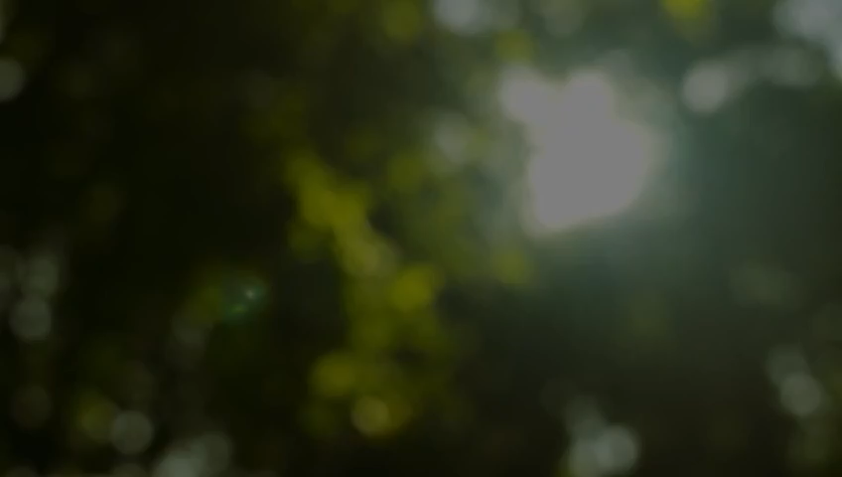

Slide 44


Slide 45
2 Corinthians 14 May the grace of the Lord Jesus Christ, and the love of God, and the fellowship of the Holy Spirit be with you all
Surely goodness and mercy shall follow me all the days of my life, and I shall dwell in the house of the Lord forever.

